Slide 1
CS 35L Software Construction Lab Week 10 – Change Management

Slide 2
Software development process
●
Involves making a lot of changes to code
New features added Bugs fixed
Performance enhancements
–
–
–
●
Software team has many people working on the same/different parts of code
Many versions of software released
●
–
Ubuntu 10, Ubuntu 12, etc
Need to be able to fix bugs for Ubuntu 10 for customers using it, even though you have shipped Ubuntu 12.
–

Slide 3
Source/Version Control
●
Track changes to code and other files related to the software
–
What new files were added?
What changes made to files?
Which version had what changes?
Which user made the changes?
–
–
–
●
Track entire history of the software Version control software
●
–
GIT, Subversion

Slide 4
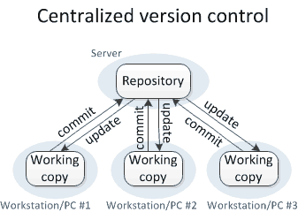
Centralized VCS
Version history sits on a central server
Users will get a working copy of the files
Changes have to be committed to the server
All users can get the changes
Ex. SVN

Slide 5
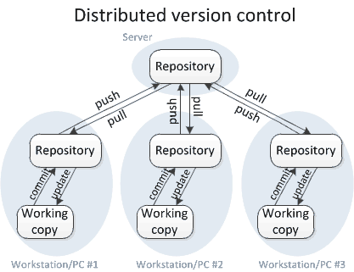
Distributed VCS
Version history is replicated at every user's machine
Users have version control all the time
Changes can be communicated between users
Ex. Git is distributed
●
●
●

Slide 6
Difference
D-VCS
These systems do not necessarily rely on a central server to store all the versions of a project’s files.
Every developer “clones” a copy of a repository and has the full history of the project on their own hard drive.
C-VCS
Single “central” copy of your project exists on a server, and you “commit” your changes to this central copy.
“Committing” means recording change in the central system which others can see.

Slide 7
Terms used
●
Repository
–
Files and folder related to the software code
Full history of the software
–
●
Working copy
–
Copy of software's files in the repository
●
Check-out
–
To create a working copy of the repository
●
Check-in / Commit
–
Write the changes made in the working copy to the repository
Commits are recorded by the VCS
–

Slide 8
GIT Source control

Slide 9

Git States
git checkout
Staging area is just to prepare your files for a commit
git add
git commit

Slide 10
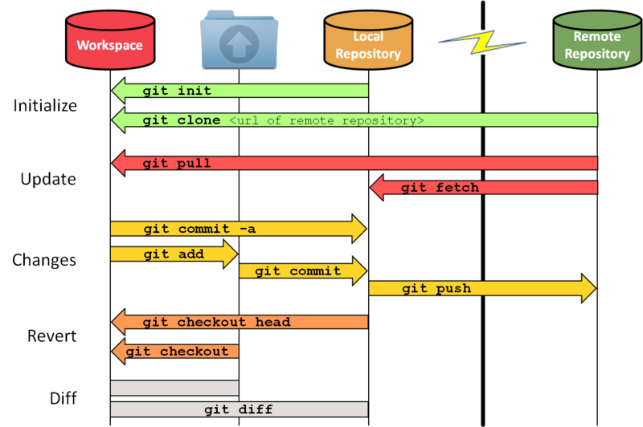
git pull does a git fetch followed by a git merge
Notes:
https://stackoverflow.com/questions/9529078/how-do-i-use-git-reset-hard-head-to-revert-to-a-previous-commit

Slide 11
First Git Repository
$ mkdir gitroot
$ cd gitroot
$ git init
creates an empty git repo (.git directory)
$ echo “Hello World” > hello.txt
$ git add .
Adds content to the index
Must be run prior to a commit
$ git commit –m ‘Check in number one’

Slide 12
Working With Git
$ echo “I love Git” >> hello.txt
$ git status
Shows list of modified files
hello.txt
$ git diff
Shows changes we made compared to index
$ git add hello.txt
$ git diff
No changes shown as diff compares to the index
$ git diff HEAD
Now we can see changes in working version
$ git commit –m “Second commit”

Slide 13
Git commands
●
Repository creation
–
$ git init
$ git clone
(Start a new repository)
(Create a copy of an existing repository)
–
●
Branching
–
$ git checkout <tag/commit> -b <new_branch_name> (creates a new branch)
●
Commits
–
$ git add
$ git commit
(Stage modified/new files)
(check-in the changes to the repository)
–
●
Getting info
–
$ git status
$ git diff
$ git log
$ git show
(Shows modified files, new files, etc) (compares working copy with staged files) (Shows history of commits)
(Show a certain object in the repository)
–
–
–
●
Getting help
–
$ git help

Slide 14
Git rebase vs merge
https://stackoverflow.com/questions/16666089/whats-the-difference-between-git-merge-and-git-rebase

Slide 15
Final Exam
When: Wednesday, December 12 - 11:30am
Venue: TBD
Paper-based, no laptops allowed!
Open book, open notes (NO Internet)
Written test (No access to linux terminals)
50% weightage
Side-note: No late submission allowed for Homework 9 & 10

Slide 16
What Is a Branch?
A pointer to one of the commits in the repo (head) + all ancestor commits
When you first create a repo, are there any branches?
Default branch named ‘master’
The default master branch
points to last commit made
moves forward automatically, every time you commit

Slide 17
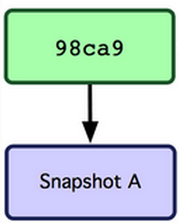
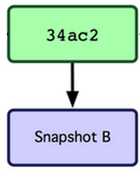
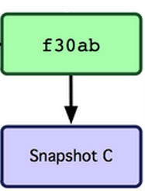
Where Is Master?
master
master

Slide 18
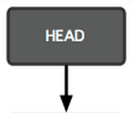
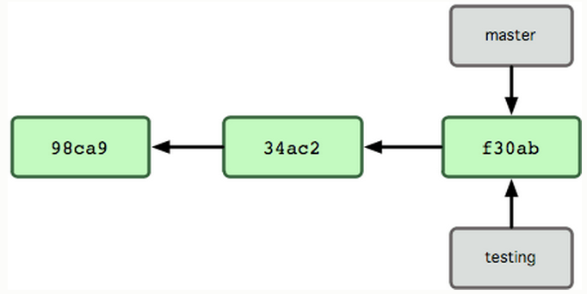
New Branch
Creating a new branch = creating new pointer
$ git branch testing
Where is new branch created?
Current commit
Where is current commit?
HEAD

Slide 19
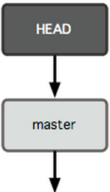
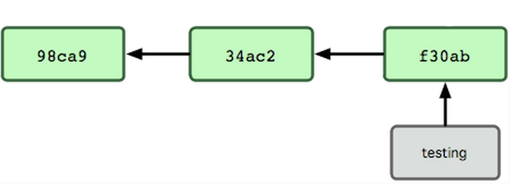
New Commit
What happens if we make another commit?
345f5

Slide 20
Switching to New Branch
Check out new branch
$ git checkout <branch_name>
$ git checkout testing

Slide 21
Steps
Create a repo on github
Clone it on your machine
git clone …..<url>
Git branch branchname
Git checkout branchname
----Now you can start working on your new branch-----
Git checkout master
----now you’re on the master branch-----
Suggestion: add different content in the files to see the diff during checkout
Try:
Git status
Git log
To get the information about the head and commits (+ their hash)

Slide 22
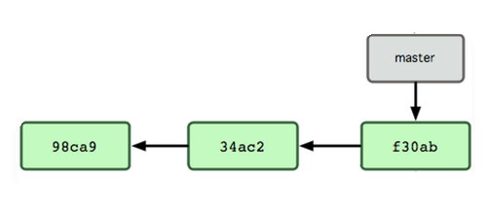

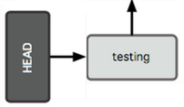
Commit After Switch

Slide 23
Why Branching?
Experiment with code without affecting main branch
Separate projects that once had a common code base
2 versions of the project

Slide 24
Branching in git
Create a new branch: git checkout –b <branchname>
Create a file and commit changes to the branch
Switch to master: git checkout master
Merge the branch: git merge <branchname>
You should now see the new file (you created in your branch) in the master’s working repo
Add, commit and push to the master
Delete the branch: git branch –d <branchname>

Slide 25
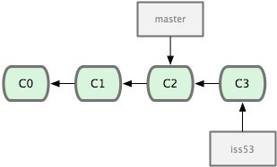
Terms used
HEAD
Points to the checked out branch <keeps track>
Detached HEAD
If a commit is not pointed to by a branch
This is okay if you want to just take a look at the code and if you don't commit any new changes
If the new commits have to be preserved then a new branch has to be created
git checkout v3.0 -b BranchVersion3.1
Branch
Refers to a head and its entire set of ancestor commits
Master
Default branch
Image Source: git-scm.com

Slide 26
More Git Commands
●
Reverting
–
$ git checkout HEAD main.cpp
●
Gets the HEAD revision for the working copy
–
$ git checkout -- main.cpp
●
Reverts changes in the working directory
–
$ git revert
●
Reverting commits (this creates new commits)
●
Cleaning up untracked files
–
$ git clean
●
Tagging
–
Human readable pointers to specific commits $ git tag -a v1.0 –m 'Version 1.0'
–
●
This will name the HEAD commit as v1.0

Slide 27
Merging
master
Need to fix a bug
Create a branch
$ git branch bugFix
$ git checkout bugFix
Make some progress
Make a commit
C0
C1
C2
C3
bugFix

Slide 28
Merging
Not done with bugFix, but need to fix
a simple but urgent bug
Go back to master:
$ git checkout master
=> Create a branch & check it out
$ git checkout –b urgentFix
Make some progress
Make a commit
master
C4
C0
C1
C2
C3
urgentFix
bugFix

Slide 29
Merging
When confident about fix, we can
merge it back into master
$ git checkout master
$ git merge urgentFix
$ git branch –d urgentFix
master
urgentFix
master
C4
C0
C1
C2
C3
bugFix

Slide 30
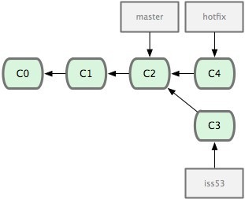
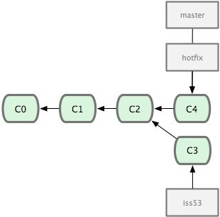
Merging
Image Source: git-scm.com
●
Merging hotfix branch into master
–
$ git checkout master
$ git merge hotfix
Git tries to merge automatically
–
–
●
Simple if its a forward merge
Otherwise, you have to manually resolve conflicts
●

Slide 31
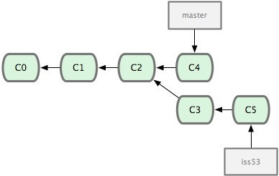
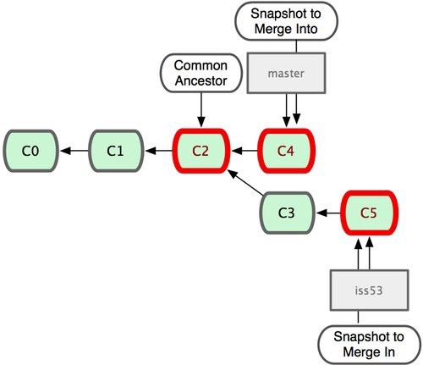
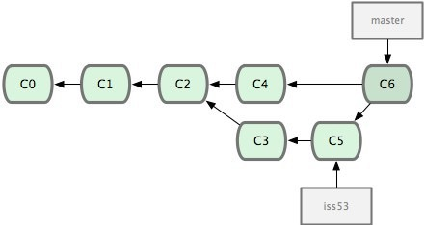
Merging
Image Source: git-scm.com
Merge iss53 into master
Git tries to merge automatically by looking at the changes since the common ancestor commit
Manually resolve the merge conflicts - Same part of the file was changed differently

Slide 32
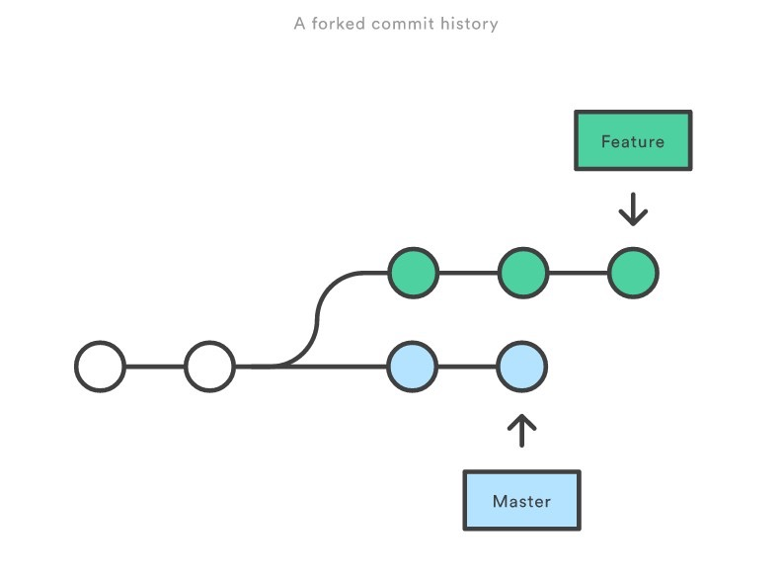
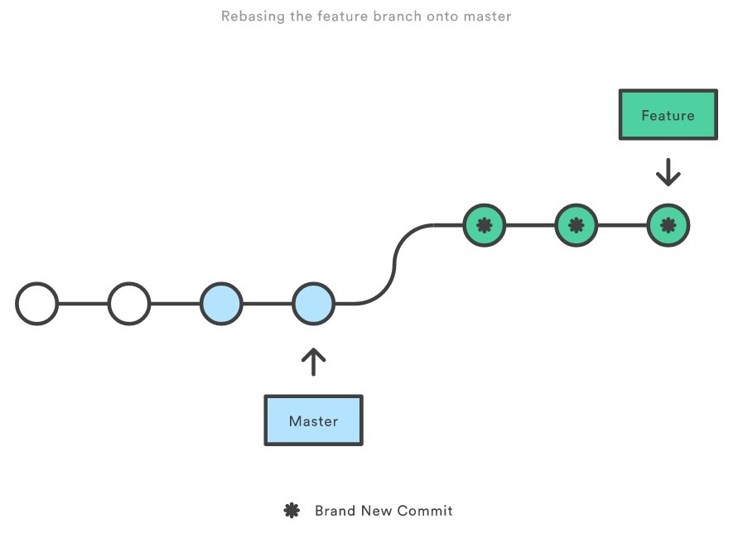
Git Rebase
Rewrites commit history.
Loses context
Never use this on public branches!
How to rebase?
–
$ git checkout feature
$ git rebase master
–
Source - https://www.atlassian.com/git/tutorials

Slide 33
Assignment 9
Installing Git
Ubuntu: $ sudo apt-get install git
SEASnet
Git is installed in /usr/local/cs/bin
Add it to PATH variable or use whole path
$ export PATH=/usr/local/cs/bin:$PATH
Make a directory ‘gitroot’ and get a copy of the Diffutils Git repository
$ mkdir gitroot
$ cd gitroot
$ git clone git://git.savannah.gnu.org/diffutils.git
Follow steps in lab and use man git to find commands

Slide 34
Lab Assignment 9
Backporting
Apply a patch to a previous version
Fix an issue with the diff diagnostic
Commands to be used
git clone
git log
git tag
git show <hash_value>
git checkout v3.0 –b <branchname>

Slide 35
Homework 9
Publish patch you made in lab 9
- Create a new branch “quote” off of version 3.0
Branch command + checkout command (git branch quote v3.0; git checkout quote)
$ git checkout v3.0 -b quote
- Use patch from lab 4 to modify this branch
Patch command
$ patch –pnum < quote-3.0-patch.txt
- Modify ChangeLog file in diffutils directory
Add entry for your changes similar to entries in ChangeLog
- Commit changes to the new branch
$ git add . $ git commit –F <Changelog file>
- Generate a patch that other people can use to get your changes
$ git format-patch -[num] --stdout > formatted-patch.txt
- Test your partner’s patch
Check out version 3.0 into a tmp branch
Apply patch with git am command: $ git am < formatted-patch.txt
Build and test with $ make check
Make sure partner’s name is in HW9.txt for #8

Slide 36
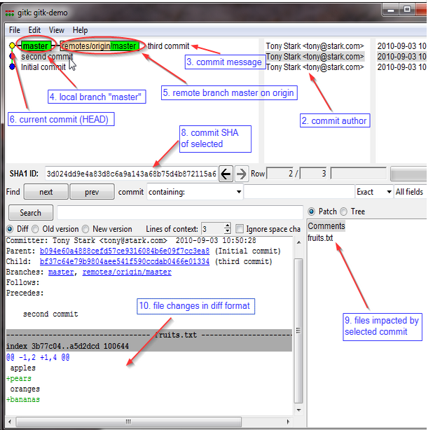
Gitk
A repository browser
Visualizes commit graphs
Used to understand the structure of the repo
Tutorial: http://lostechies.com/joshuaflanagan/2010/09/03/use-gitk-to-understand-git/

Slide 37
Gitk
SSH into the server with X11 enabled
ssh -X for OS with terminal (OS X, Linux)
Select “X11” option if using putty (Windows)
Run gitk in the ~eggert/src/gnu/emacs directory
Need to first update your PATH
$ export PATH=/usr/local/cs/bin:$PATH

